Slide 1

COMPUTER VISION Assignment – 1 FACULTY : Dr. Tilottama Goswami
IT – B
K. PRASANNA REDDY (1602-20-737-093)
K. PRANEETH (1602-20-737-092)

Slide 2
EDGE DETECTION
Gaussian based Algorithms used :
Canny operator
Laplacian operator

Slide 3
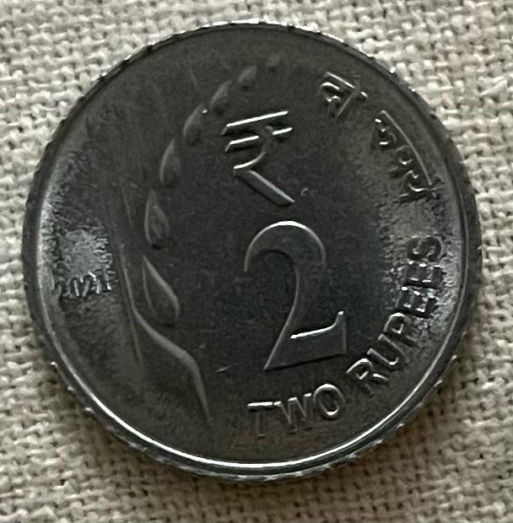
Input image

Slide 4
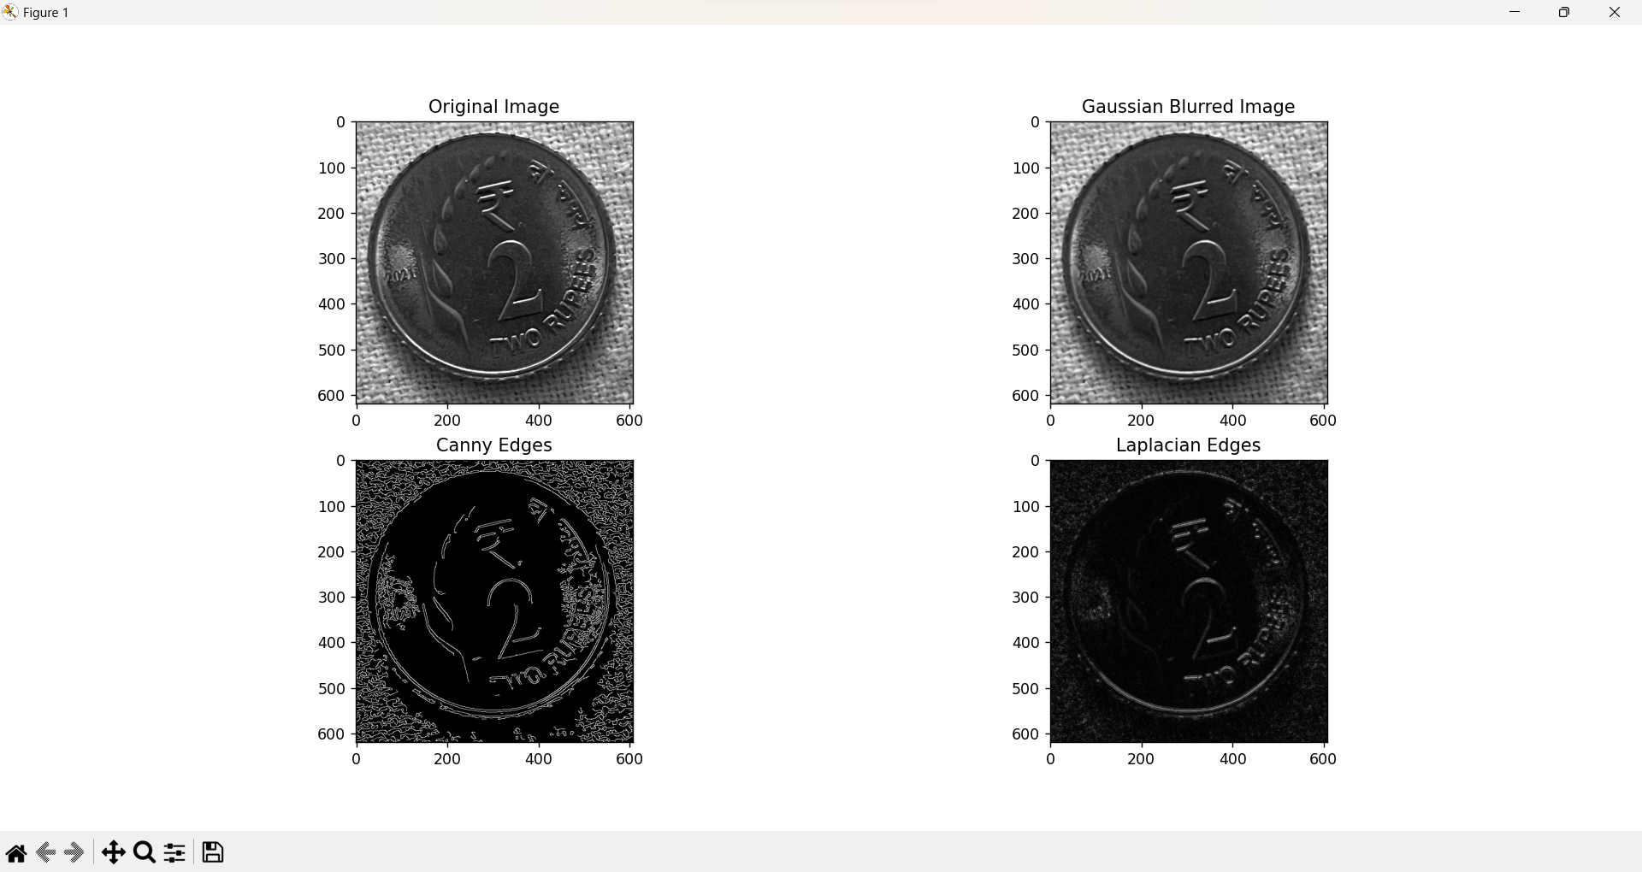
output

Slide 5
Conclusion
The Canny filter is a more sophisticated and widely used filter for edge detection. It consists of four main steps: smoothing, gradient calculation, non-maximum suppression, and hysteresis thresholding. Smoothing is done by applying a Gaussian filter to the image to reduce noise.
Laplacian is very sensitive to noise, as it amplifies any small variation in pixel intensity, and that it does not provide information about the edge direction or orientation.

Slide 6

THANK YOU

